Slide 1
CANADA’s LABOUR FORCE: CHANGES & GROWTH OVER 30 YEARS
NOVEMBER 13, 2019 PREPARED BY Amir, Andy, Dan, Jenny, Jhenny

Slide 2
Motivation & Summary
MOTIVATION
Started with the question: Which industries have experienced the most growth in Canada and what has contributed to this growth?
Refined to look more specifically into a specific sector: What growth has the technology industry experienced within Ontario over the last 20 years and what has contributed to this growth?
Based on data availability, updated question(s) to: Which labour markets have experienced the most/least growth within Canada over the last 30 years? Does technology play a role in this growth, if so, what is the composition of this sector? What other influences may be a factor?
SUMMARY
Our project is to uncover what growth the labour force experienced over last 30 years across Canada. We examined Industry sectors which have experienced the most/least growth. We undertook analysis to explore potential factors/characteristics that influenced this growth, including looking at the relationship between economic (GDP) and Academic factors (other factors were considered for future analysis – e.g. immigration trends, population growth, tax incentives etc.). The data will allow us to define areas of focus for opportunities in technology sector growth.

Slide 3
Questions & Data
The specific questions we set out to answer were:
Which NAICS sectors have experiences the largest growth within the Canadian labour force within the last 30 years? What are the top/bottom 5?
Of the top NAICS sectors, which is most related to ‘technology’? Does it exist within the top 5?
If so, what are the micro trends as they relate to gender, geography and age?
What might be an influence on the growth of this NAICS category?
Area of Post-Secondary Study
GDP
Datasets Used:
https://www150.statcan.gc.ca/t1/tbl1/en/tv.action?pid=1410002301
https://www150.statcan.gc.ca/n1/tbl/csv/37100011-eng.zip
https://www150.statcan.gc.ca/n1/tbl/csv/36100449-eng.zip

Slide 4
Data Cleanup & Exploration
Began with questions & looked through data sources found online
Found ‘technology’ growth data hard to find – this is not yet defined as a separate industry
This led us to pivot our question
Sourced census data for 2016 and 2006
Data from 2006 was in an unusable format which we could not extract or transform
Much of the data was available within both census reports
Re-visited data to be used and sourced new data to compare to 2016 census
Once data sources gathered, some sources were still very large for a single computer processor (heavy, hard to load)

Slide 5
Data Analysis
Discuss the steps you took to analyze the data and answer each question you asked in your proposal
1. Looked through the data to create a date frame that had relevant data to our question such as sex, labour force characteristics, age groups ,etc.
2. group the data in a 30 year and calculate the percentage change for each industry
3. sort the data by ascending and descending to figure out the top 5 and bottom 5 industry in terms of percentage change
Present and discuss interesting figures developed during analysis, ideally with the help of Jupyter Notebook

Slide 6
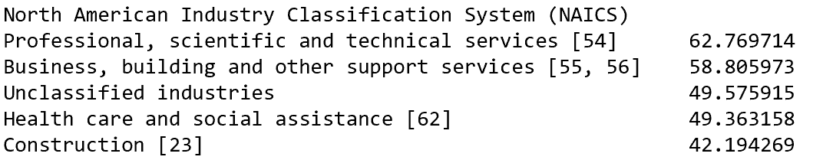
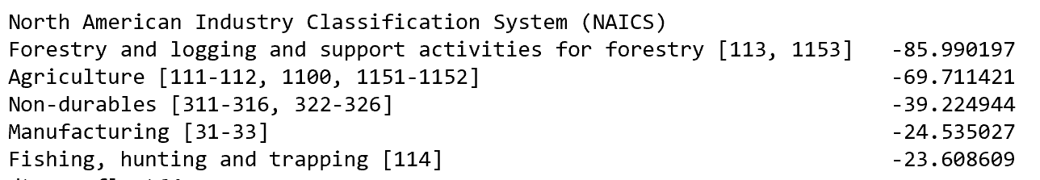
Data Analysis & Insights: TOP 5 & BOTTOM 5 LABOUR FORCE TRENDS
STATEMENT ABOUT OVERALL RESULTS
Top 5 conclusion:
Top 5: Professional, scientific and technical services, Business, building and other support services, Unclassified industries , Health care and social assistance, Construction.
Bottom 5 conclusion:
Bottom 5: Forestry and logging and support activities for forestry, Agriculture, Non-durables, Manufacturing, Fishing, hunting and trapping
Any interesting observations:
Winners: Services based industries especially in STEM and Finance industries.
Losers: Agriculture and Resource based industries.
The above observations show the shift toward a more knowledge and services-based economy.

Slide 7
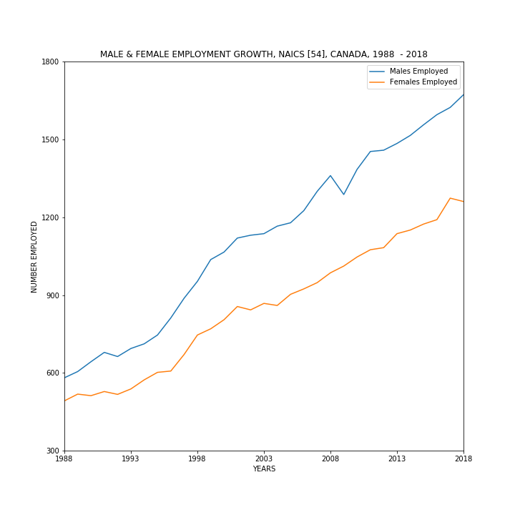
Data Analysis & Insights: GENDER ANALYSIS
WHILE BOTH GENDERS HAVE EXPERIENCED GROWTH IN EMPLOYMENT WITHIN NAICS 54 IN CANADA, THE GENDER GAP WIDENED FROM 1998 – 2018
The NAICS categorization most closely related to ‘technology’, which was also the largest growing category within total labour force trends from 1998 – 2018, was category [54] – Professional, Scientific and Technical Services*
Overall growth from 1998 – 2018 for Males was 188% and for Females was 156% (total employment growth of 173%)
When comparing the growth of employed male and female workforce within this sector, notable years of most impact included 1996 – 1998 for both genders as well as 2009 for the male workforce
1996 – 1997: Male employment grew at its highest rate of 9%
1997 – 1998: Female employment grew at its highest rate of 11%
2008 – 2009: Male employment dropped by 5%
*Legal services; accounting, tax preparation, bookkeeping and payroll services; architectural, engineering and related services; specialized design services; computer systems design and related services; management, scientific and technical consulting services; scientific research and development services; and advertising, public relations, and related services

Slide 8
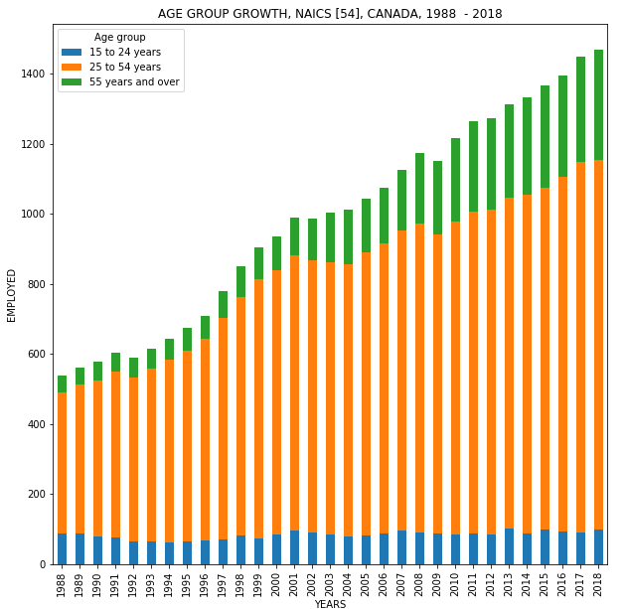
Data Analysis & Insights: AGE GROUP ANALYSIS – Employment trend
This bar chart give information about the age group of the employees have been shown in this bar chart. According to this chart, the majority of employees age are in range of 25 to 54 years.
The number of employees started from 500 employees in 1988 and gradually increased to approximately 1100 by 2018.
Two interesting points to note:
The 55 yrs+ age cohort has grown larger over the 30 years study period indicating that more “senior” workers are staying employed longer within the industry
The absolute size of the 25 to 54 yrs cohort has grown over the study period due to the entry of the “millennia Generation” into the workforce starting in 1998.

Slide 9
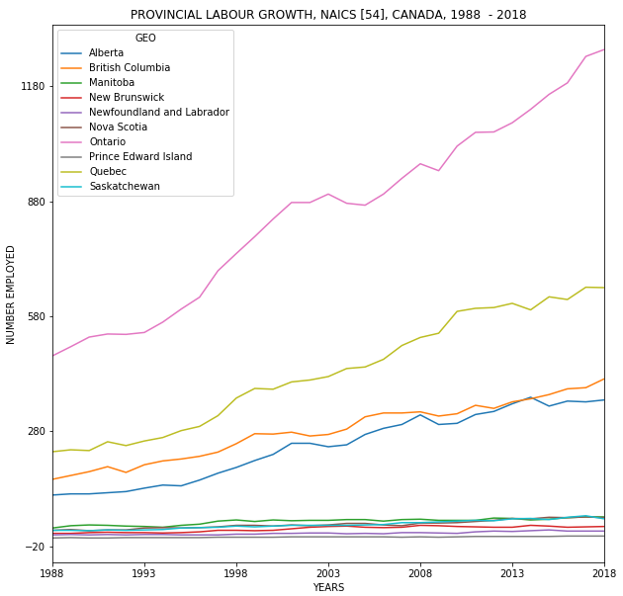
Data Analysis & Insights: PROVINCIAL ANALYSIS – Employment Trend
The chart indicate the changes in number of employment between 1988 and 2018 in all the provinces in Canada. As the chart shows, the following four provinces had highest to lowest increase in their number of employment.
Ontario (started at around 500 to more than 1200)
Quebec
British Columbia
Alberta
And the other provinces did not experience great difference in the same span of time.

Slide 10
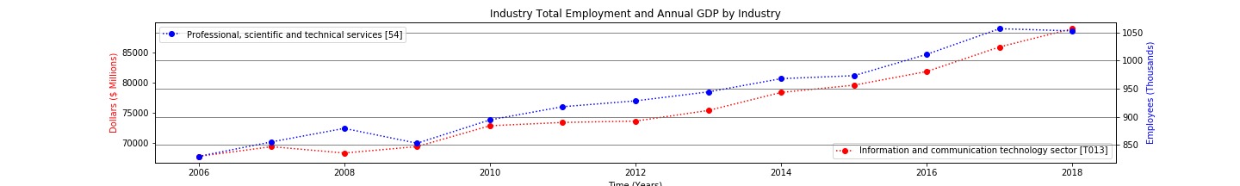
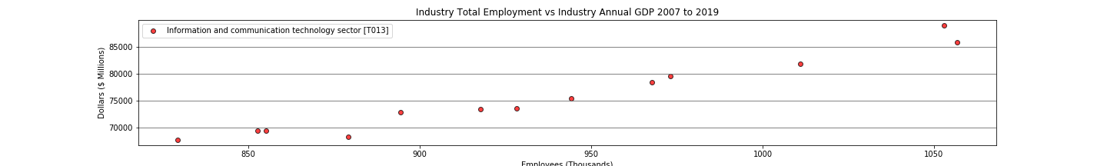
Data Analysis & Insights: Industry Employment & GDP Trend
We examined Industry employment (at a national level) for the industry that achieved the largest gain over the past 30 years (Professional, Scientific, and Technical Services [54]) against the corresponding Industry GDP (at a national Level) under the hypothesis that the two are intuitively related.
Both the employment trend and the GDP trend of the industry increase over the period and appeared to move together across time with a few years around 2008 where GDP declined (recession) to be followed by a dip in employment in 2007, indicating that GDP (economic performance) leads employment – as one would intuitively suspect.
Given the above chart which suggests a relationship between Industry GDP (economic performance ) and Industry Employment Rates, a scatterplot and correlation analysis was undertaken to prove out that relationship.
The scatter plot of Industry employment vs Industry GDP over the 12-year period 2006 to 2012 below clearly shows a linear positive relationship. Correlation analysis run against those series yields a correlation of 0.9791 indicating a strong positive relationship between the two series, validating the intuition that Industry Economic performance and Industry Employment rates are related to each other.

Slide 11
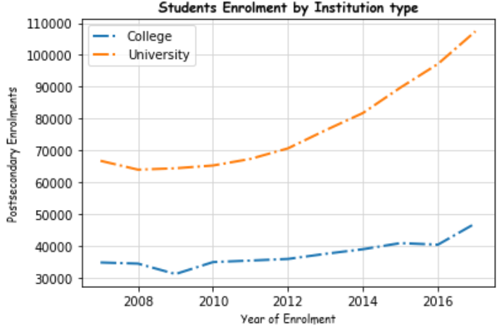
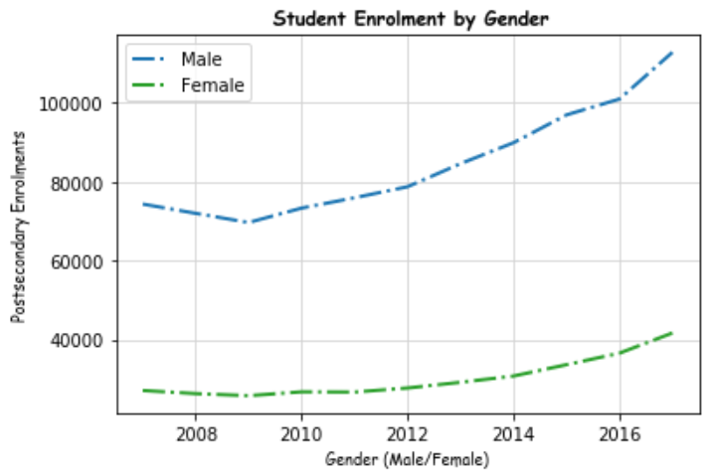
Data Analysis & Insights: Mathematics, Computer & Information Sciences University and College Enrollment Trend
We examined Stats Canada Post Secondary Student Enrolment information at a national level for the technology careers versus the institution type & Gender Participation with the objective to understand the job demand versus enrolment numbers.
University versus College
In 2016, 22.4% of Canadians aged 25 to 64 had a college diploma, 3.1% had a university certificate below bachelor's degree and 28.5% had a bachelor's degree or higher, adding up to 54.0% of Canadians aged 25 to 64 with either college or university qualifications.
Chart 1 illustrates the steady increase of student enrolment in higher level education institutions with a trend upwards on both colleges and universities, with the exception of 2008-10 due financial crisis that year.
Gender Participation
The tech industry has a significant disparity in gender as shown in chart 2, engineering and computer science have remained largely male fields of study at universities in Canada.
The top 10 Canadian information and communications technology companies (ICT) have an average of 16.5 per cent female representation versus the 26% of the enrolment participation in 2017.
Sources : https://www.statcan.gc.ca/eng/topics-start/gender_diversity_and_inclusion
Statistics Canada. Table 37-10-0011-01 Postsecondary enrolments, by program type, credential type, Classification of Instructional Programs, Primary Grouping (CIP_PG), registration status and sex

Slide 12
Discussion
Findings:
Not able to answer the initial question due to data acquisition issues.
Winners: Services based industries especially in STEM and Finance industries.
Losers: Agriculture and Resource based industries.
The above observations show the shift toward a more knowledge and services-based economy.
Growth rate stronger for males employed
The tech industry has a significant disparity in gender, engineering and computer science have remained largely male fields of study at universities in Canada.
Growth rate were higher where provinces with more industries and population.
Industry GDP (economics) and Industry employment highly correlated with GDP leading employment.

Slide 13
Post Mortem
Discuss any difficulties that arose, and how you dealt with them:
Lack of clarity in defining the initial question led to difficulty in sourcing appropriate data for analysis.
Available datasets were too large to be effectively extracted, cleansed/transformed and analyzed.
Led to a limiting of the type of analysis and insights that could be drawn from the data set we ended up using.
Discuss any additional questions that came up, but which you didn't have time to answer: What would you research next, if you had two more weeks?
More time could have been spent to morel clearly define the original question that would allow the acquisition of cleaner more focussed datasets.
More granular analysis across the different data characteristics.
I.e. Compare gender, geo, age details for NAICS 54 to that of the other top 4 NAICS labour groupings – further identifying the difference in growth trends.
Additional data sets could be sourced to build out a more robust set of characteristic factors that could drive deeper correlation analysis.
I.e. Government incentives (SRED, NC IRAP), Immigration, Venture Capital Investments

Slide 14


Slide 15
REFERENCE
54 - Professional, scientific and technical services
This sector comprises establishments primarily engaged in activities in which human capital is the major input. These establishments make available the knowledge and skills of their employees, often on an assignment basis. The individual industries of this sector are defined on the basis of the particular expertise and training of the service provider. The main components of this sector are legal services; accounting, tax preparation, bookkeeping and payroll services; architectural, engineering and related services; specialized design services; computer systems design and related services; management, scientific and technical consulting services; scientific research and development services; and advertising, public relations, and related services. The distinguishing feature of this sector is the fact that most of the industries grouped in it have production processes that are almost wholly dependent on worker skills. In most of these industries, equipment and materials are not of major importance. Thus, the establishments classified in this sector sell expertise. Much of the expertise requires a university or college education, though not in every case. Establishments primarily engaged in providing instruction and training in a wide variety of subjects and those primarily engaged in providing health care by diagnosis and treatment are not included in this sector.
http://www23.statcan.gc.ca/imdb/p3VD.pl?Function=getVDStruct&TVD=380372&CVD=380373&CPV=54&CST=01012017&CLV=1&MLV=5

Slide 16
REFERENCE
Unclassified Industry
The Unclassified industry (999999) is used by Quarterly Census of Employment and Wages to categorize businesses who did not report a NAICS code. These are mostly newer businesses who have not yet determined their proper NAICS code. The BLS sends a special form to these businesses to help them determine their proper NAICS so that future reporting is improved.

